Slide 1
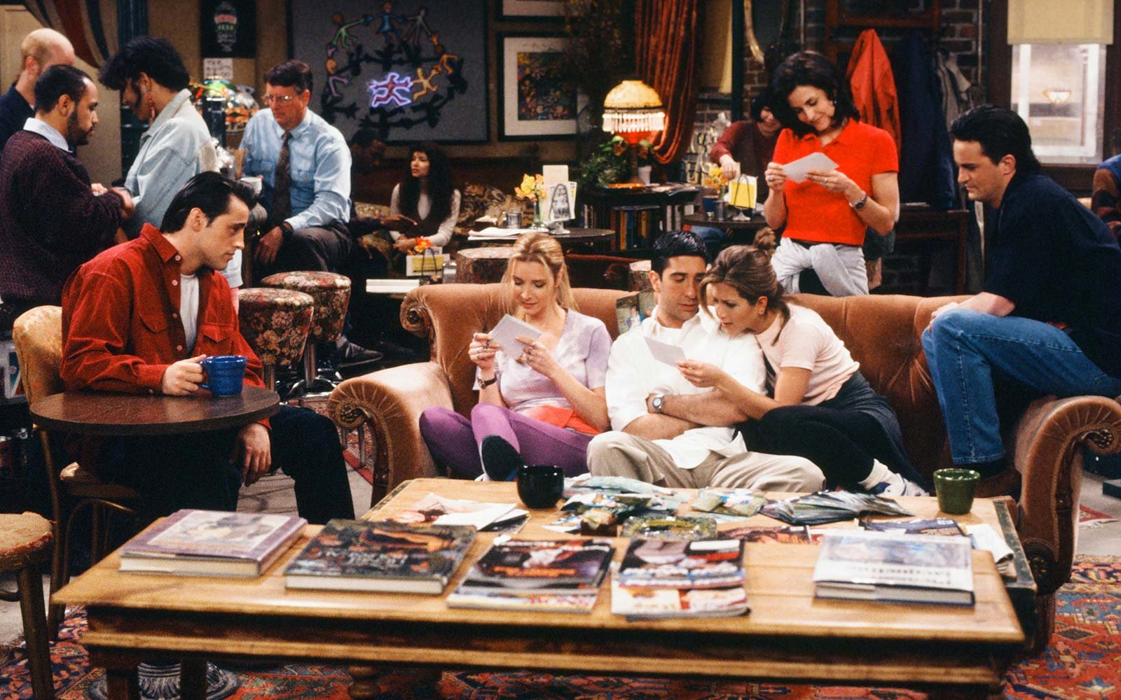

Slide 2












$$N\left(t\right)$$
$$δ_{3}$$
$$3$$
$$2$$
$$δ_{2}$$
$$δ_{1}$$
$$1$$
$$0$$
$$t$$
$$T_{1}$$
$$T_{2}$$
$$T_{3}$$

Slide 3



$$N\left(t\right)$$
$$δ_{3}$$
$$3$$
$$2$$
$$δ_{2}$$
$$δ_{1}$$
$$1$$
$$0$$
$$t$$
$$0.5$$
$$1$$
$$1.5$$

